Slide 1
Basic Game Object Manipulation and Transformations

Slide 2
Objectives
Understand the concept of game objects and their role in Unity.
Learn basic game object manipulation techniques.
Grasp the fundamentals of transforming game objects in Unity.

Slide 3
What are Game Objects?
GameObjects are the foundational components of a Unity game project.
“GameObjects are the fundamental objects in Unity that represent characters, props and scenery. They do not accomplish much in themselves but they act as containers for Components, which implement the functionality.”^{[8]}
Every object in your game is a GameObject, from characters and collectible items to lights, cameras and special effects.
2: Buttfield-Addison Paris, Manning Jon, Nugent Tim, Unity game development cookbook: essentials for every game, 2019
8: Unity Technologies, Unity Manual, 2023

Slide 4
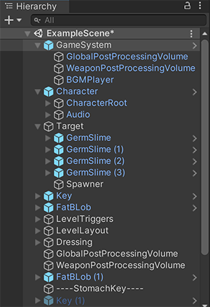
Hierarchy Panel - GameObjects - Nested
A parent GameObject has other GameObjects connected to it that take on its Transform properties.
A child GameObject is connected to another GameObject, and takes on that GameObject’s Transform properties.
A child GameObject moves, rotates, and scales exactly as its parent does. Child GameObjects can also have child GameObjects of their own. A GameObject can have multiple child GameObjects, but only one parent GameObject.
Notes:
Nesting is the term for establishing a relationship between two or more items

Slide 5
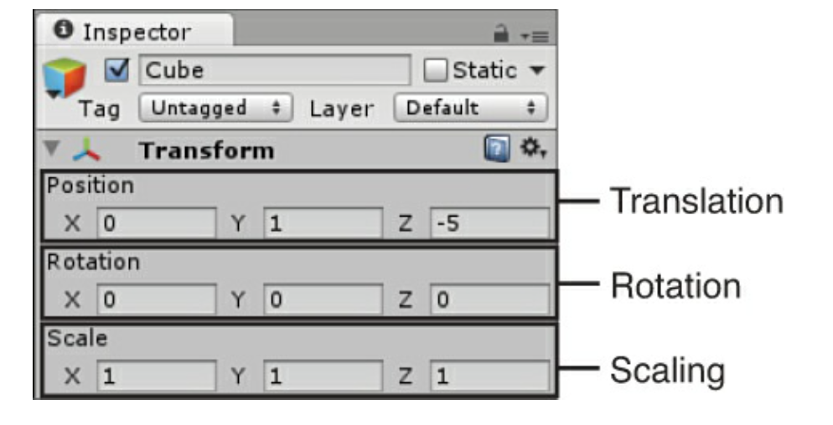
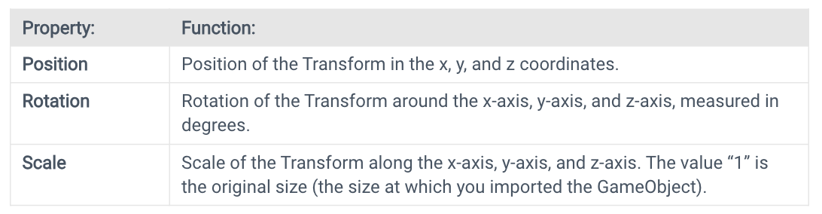
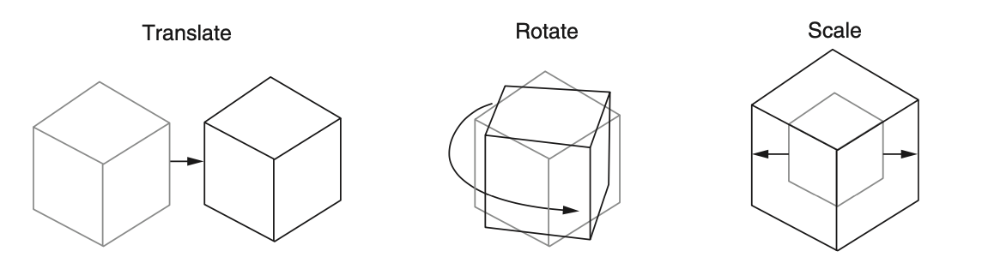
Transforms
“The Transform stores a GameObject’s Position, Rotation, Scale and parenting state. A GameObject always has a Transform component attached: you can’t remove a Transform or create a GameObject without a Transform component.”^{[8]}
1: Hocking, Joseph; Schell, Jesse, Unity in action: multiplatform game development in C#, 2022
3: Geig, Mike, Sams teach yourself Unity Game development in 24 hours, 2014
Notes:
“Every game object has at least one component: a Transform. The Transform component stores the position, rotation, and scale of an object, and is also responsible for keeping track of the parent of an object. You can’t remove the Transform component”[2]

Slide 6
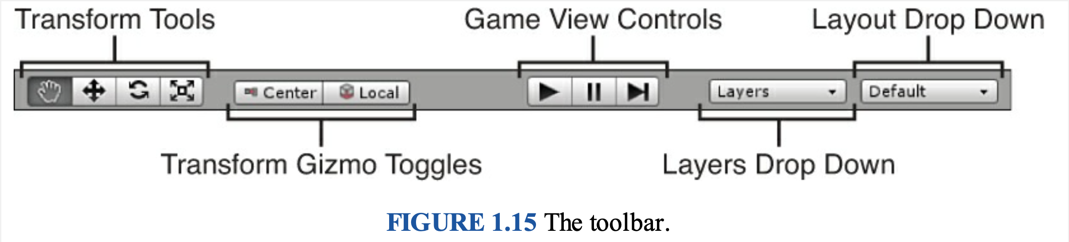
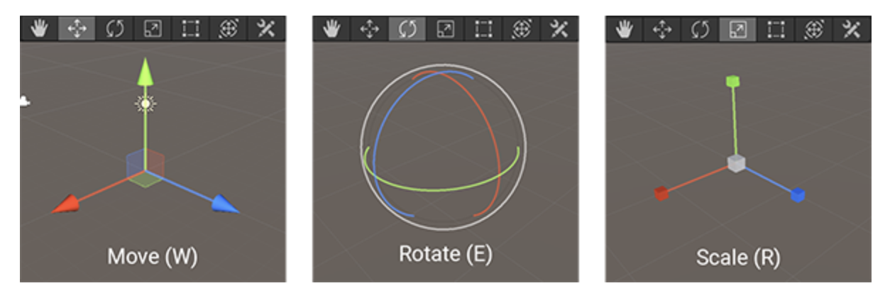
Transform Tool
You can use the Transform tools on any GameObject in a scene.
When you select a GameObject, the tool Gizmo appears within it. The appearance of the Gizmo depends on which tool you select.

Slide 7
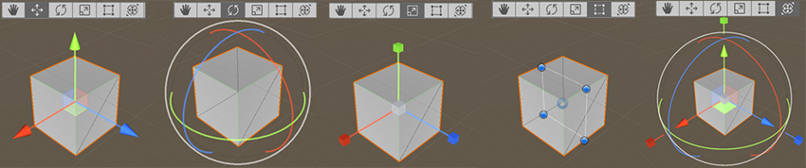
Scene View – Position GameObjects
RectTransform (T)
The RectTransform is commonly used for positioning 2D elements such as Sprites or UI elements, but it can also be useful for manipulating 3D GameObjects. It combines moving, scaling and rotation into a single Gizmo.
Transform (Y)
The Transform tool combines the Move, Rotate and Scale tools. Its Gizmo provides handles for movement and rotation. When the Tool Handle Rotation is set to Local (see below), the Transform tool also provides handles for scaling the selected GameObject.

Slide 8
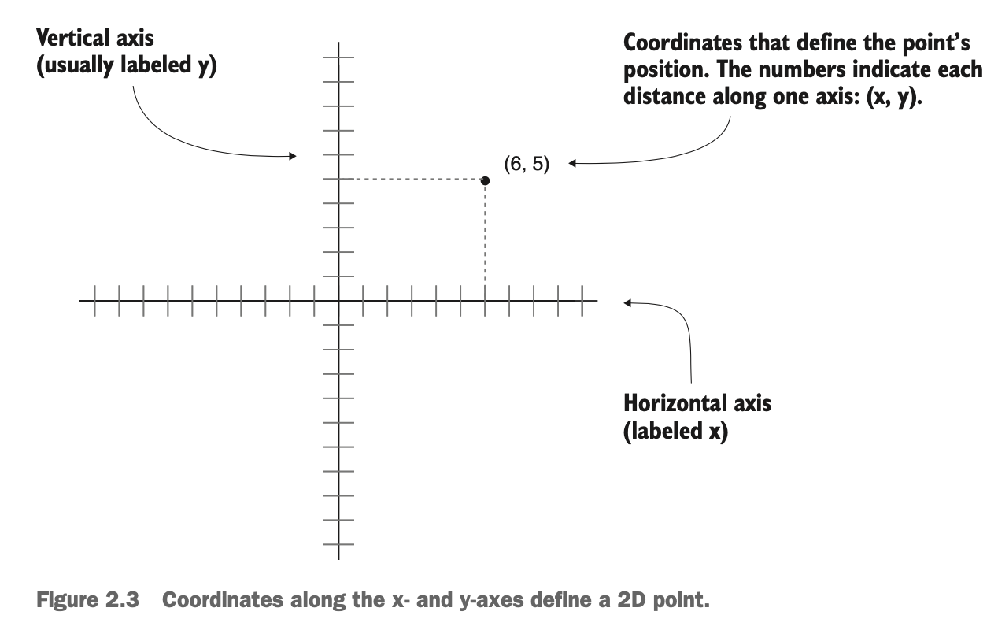
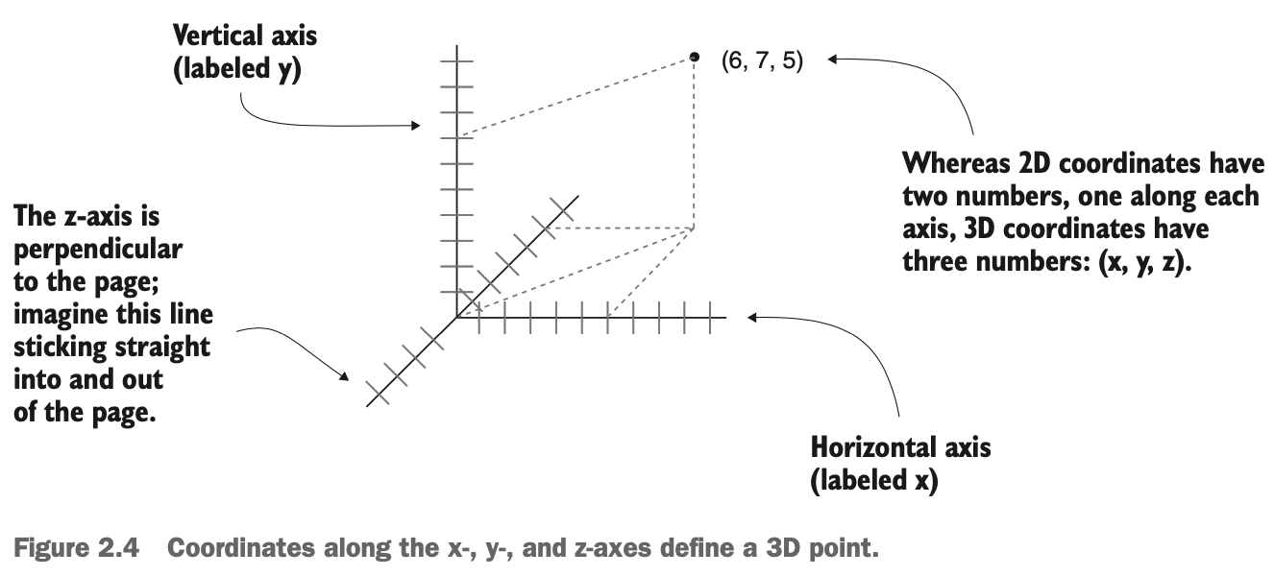
Transforms - Understanding 3D coordinate space
1: Hocking, Joseph; Schell, Jesse, Unity in action: multiplatform game development in C#, 2022

Slide 9
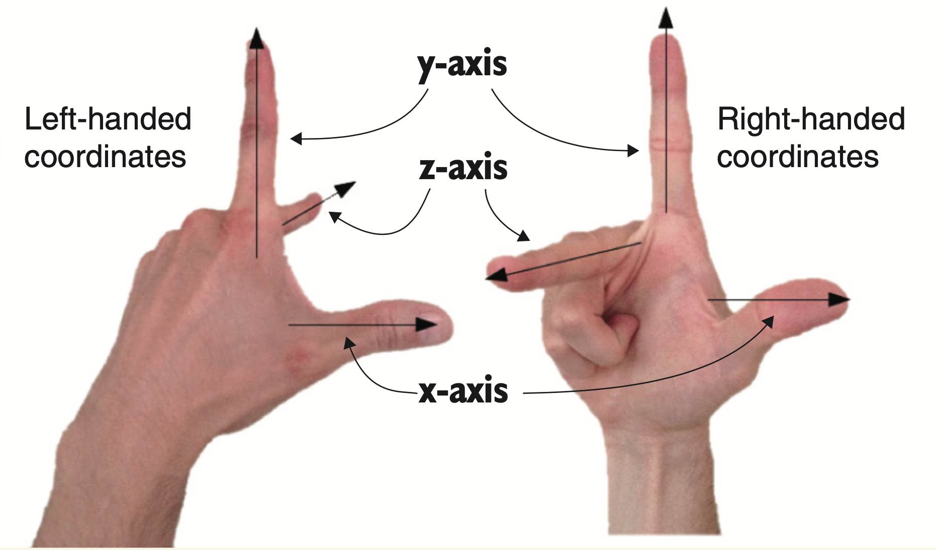
Transforms - Understanding 3D coordinate space
Left-handed vs. right-handed coordinates
The positive and negative direction of each axis is arbitrary, and the coordinates still work no matter in which direction the axes point. You simply need to maintain consistency within a given 3D graphics tool (animation tool, game development tool, and so forth).
But in almost all cases, x goes to the right and y goes up; what differs between different tools is whether z goes into or comes out of the page. These two directions are referred to as left-handed or right-handed; as this figure shows, if you point your thumb along the x-axis and your index finger along the y-axis, then your middle finger points along the z-axis.
The z-axis points in a different direction on the left hand versus the right hand.
1: Hocking, Joseph; Schell, Jesse, Unity in action: multiplatform game development in C#, 2022

Slide 10
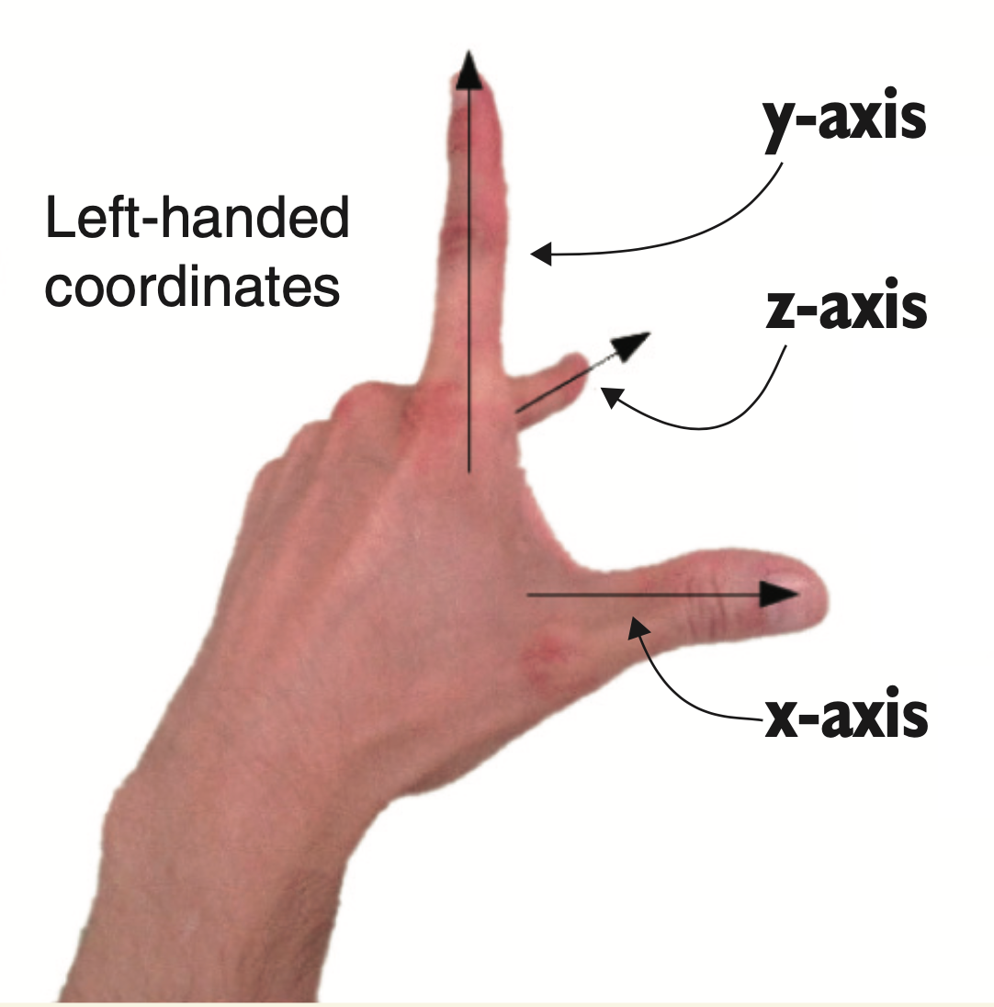
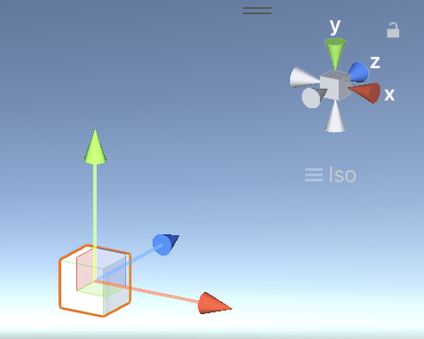
Transforms - Understanding 3D coordinate space
Unity uses a left-handed coordinate system, as do many 3D art applications.
Many other tools use right-handed coordinate systems (ex: OpenGL), so don’t get confused if you ever see different coordinate directions.
1: Hocking, Joseph; Schell, Jesse, Unity in action: multiplatform game development in C#, 2022

Slide 11
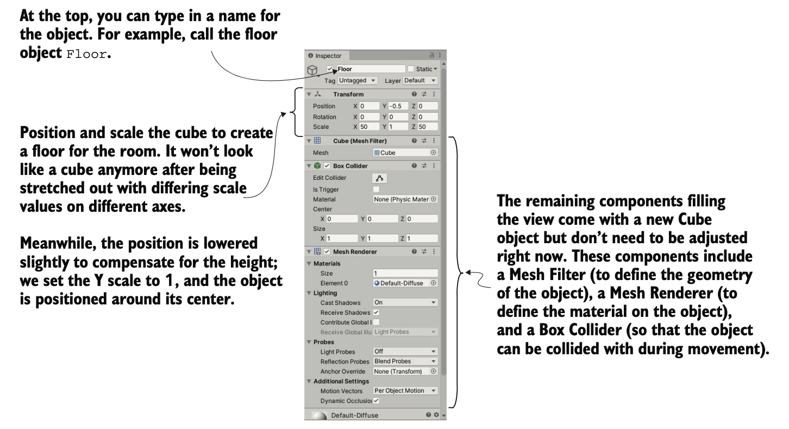
Transform Component in Inspector
1: Hocking, Joseph; Schell, Jesse, Unity in action: multiplatform game development in C#, 2022

Slide 12
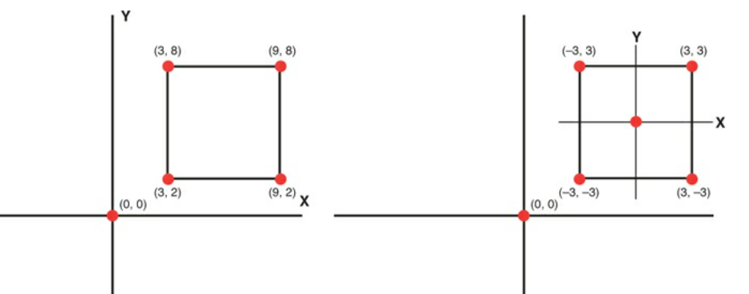
Understanding local vs. world coordinate space
Every game object in Unity has a position, but a position needs a reference frame. In particular, Unity offers two ways to see (and set) coordinates:
World coordinates: These are absolute coordinates of where the game object is located (by absolute, I mean with respect to the world frame, which is considered to be absolute in the game)
Local coordinates: These are the coordinates of where the game object is with respect to its parent

Slide 13
Parenting and Child Relationships
“Game objects can be the child of other game objects. When a game object moves, rotates, or scales, its children are affected as well. This means that you can create hierarchies of game objects that work together as a system; for example, a car could have each of its four wheels as child objects, which means that they automatically stay in the correct position as the car moves around.”^{[2]}
TIPs: Before linking any child objects to it, make sure to reset the Trans- form options (Position and Rotation to 0, 0, 0 and Scale to 1, 1, 1) of the empty root object to avoid any oddities in the position of child objects.
2: Buttfield-Addison Paris, Manning Jon, Nugent Tim, Unity game development cookbook: essentials for every game, 2019
Notes:
Transformations applied to the parent object work as normal. The object can be moved, scaled, and rotated. What’s special is how the child object behaves. Once nested, a child object’s transform is relative to that of the parent object, not the world. Therefore, a child object position is not based on its distance from the origin, but the distance from the parent object. If the parent object is rotated, the child object would move with it. If you looked at the child’s rotation, however, it would not register that it had rotated at all. The same goes for scaling. If you scale the parent object, the child also changes in size. The scale of the child object would remain unchanged.
You might be confused by why this is. Remember, when a transformation is applied, it is not applied to the object, but to the object’s coordinate system. An object isn’t rotated, its coordinate system is. The effect is that the object turns. When a child object’s coordinate system is based on the local coordinate system of the parent, any changes to the parent system will directly change the child (without the child knowing about it).
[3]

Slide 14
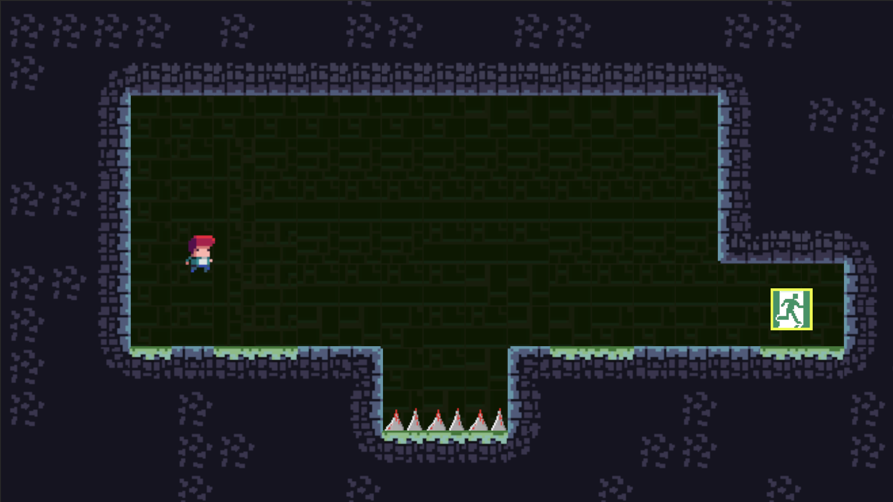
Practice
In order to understand the moving of GameObject’s transform, use Unity 2D for this practice to create a scene and Player GameObject.
The exercise will take 20 minutes, and students need to familiarize themselves with operations in the scene windows, using tools such as move, rotate, scale, zoom in, and zoom out.
Proficiency in navigating the scene window is crucial when working on a game project. Necessary components such as tiles, sprites, game objects, etc., have already been created; students only need to download and import them into the project.
Rick Davidson, Complete C# Unity Game Developer 2D, 2023
Notes:
Students need to follow the next slide's instructions to practice with Unity.
Practice Resources sharing:
https://drive.google.com/drive/folders/1eXu20cX1o-5uMFuSeHGxRS5AkhDZJTOP?usp=sharing
For lecturer: open file in: ./Lecturer-Guide/1.2_Basic-Game-Object.mp4
And user Assets file in ./Lecturer-Guide/Assets/1.2_Basic-Game-Object/*
To create the final project.

Slide 15
Practice – GameObject
Create a new Unity 2D project.
Download the asset files. Drag and drop all folders to the Asset folder of the Unity 2D project.
Rick Davidson, Complete C# Unity Game Developer 2D, 2023

Slide 16
Practice – GameObject
Create new Scene.
In the Project window, navigate to Assets > Prefabs > 1.2_Basic-Game-Object. Drag and drop ./Assets/Prefabs/Tilemap Grid.prefab into the Hierarchy window or the Scene window.
Note: Remember to select "Reset Transform" each time you add a GameObject to the Scene.

Slide 17
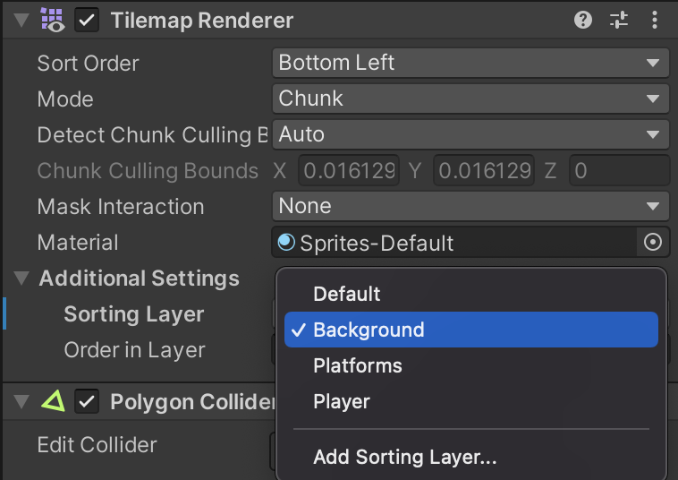
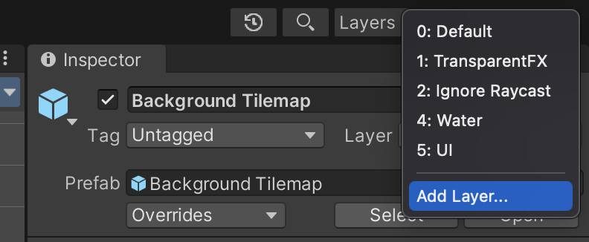
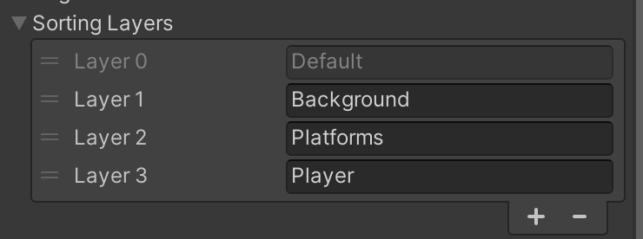
Practice – GameObject
Unity 2D layer setting
Select ‘Background Tilemap’, on inspector window, click Layer > Add Layer.
In the sorting layer section, click the '+' button and add 3 layers: Background, Platform, Player. Arrange them in the order of their intended display.
In component Tilemap Renderer - Additional Settings, set ‘Sorting Layer’ to ‘Background’.

Slide 18
Practice – GameObject
Perform the aforementioned step 3 for the remaining GameObjects within the 'Tilemap Grid' with the Sorting Layer set to Platforms.
Add the 'Exit' GameObject to the scene, adjust its Transform if necessary, and set the Sorting Layer to Platform.
Add the 'Ginger (Player)' GameObject to the scene, adjust its Transform if needed, and set the Sorting Layer to Player.
Finally, delete the default Main Camera in the scene and add 'Cameras' by dragging and dropping it from the Prefabs folder.

Slide 19
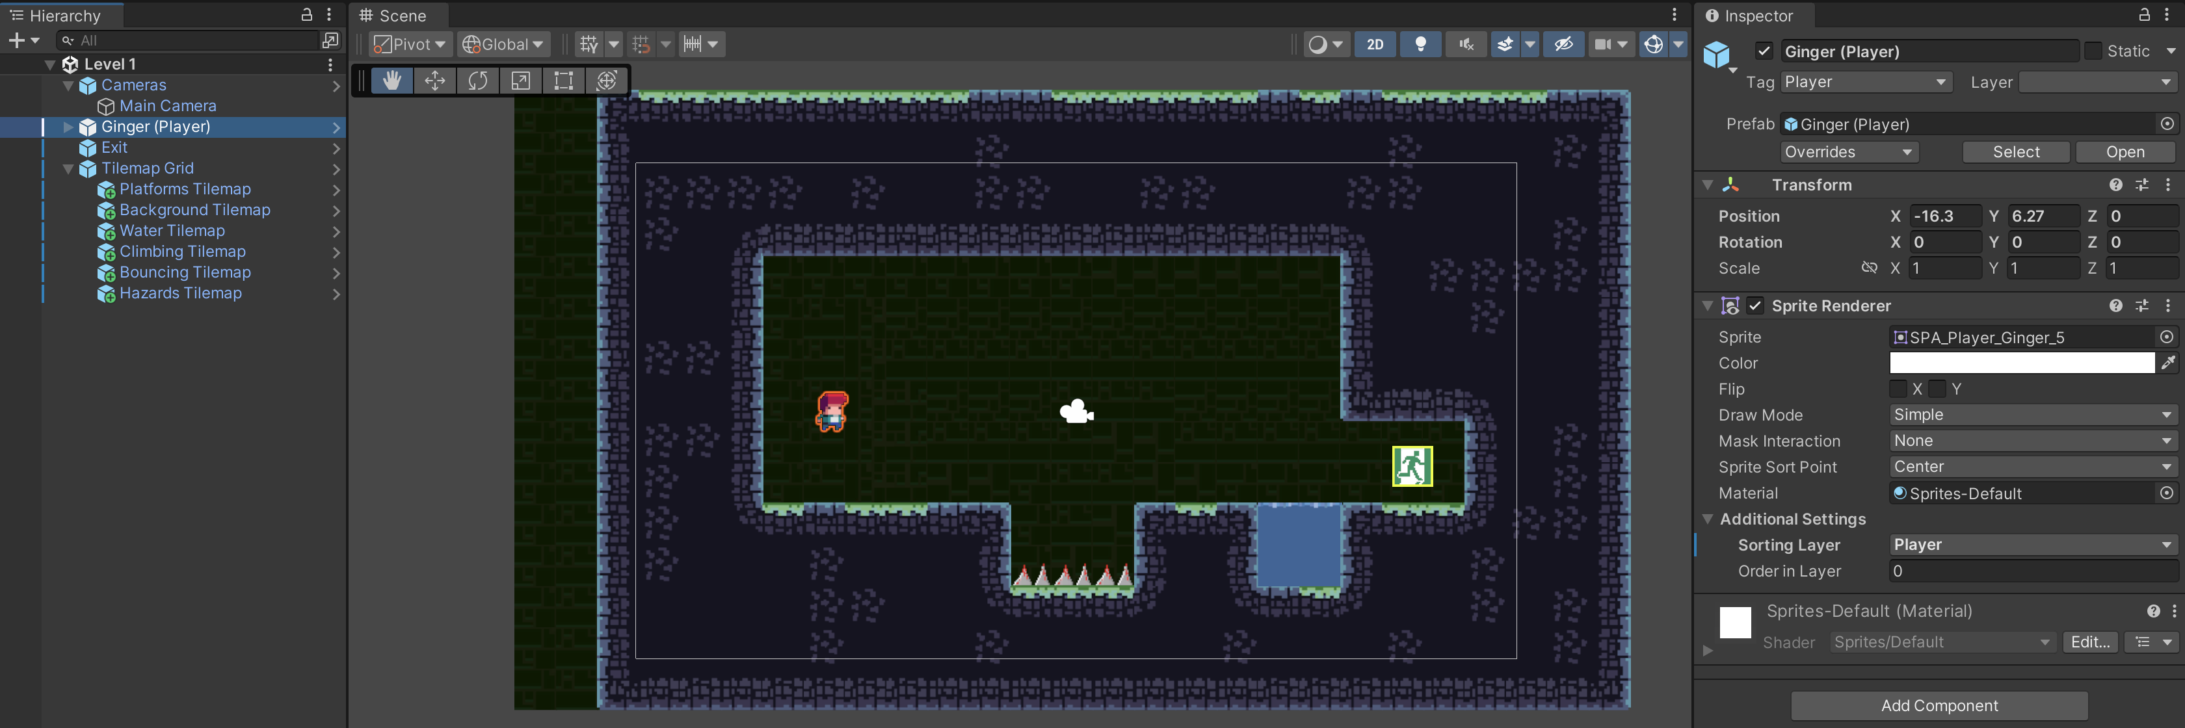
Practice – GameObject
Press Play button (Ctrl + P) to test the new scene.
Rick Davidson, Complete C# Unity Game Developer 2D, 2023

Slide 20
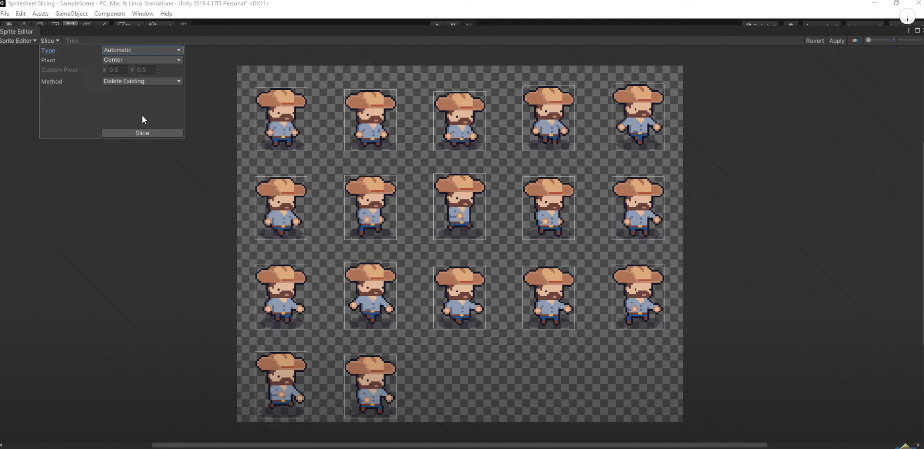
Tutorial – How to slice a sprite sheet in Unity
https://www.youtube.com/watch?v=_gDSfZ01GVE

Slide 21
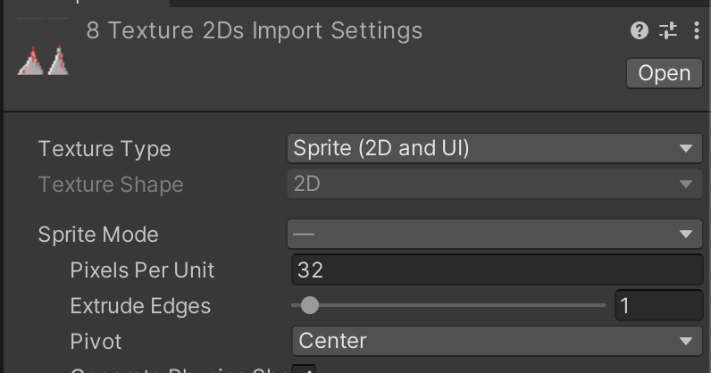
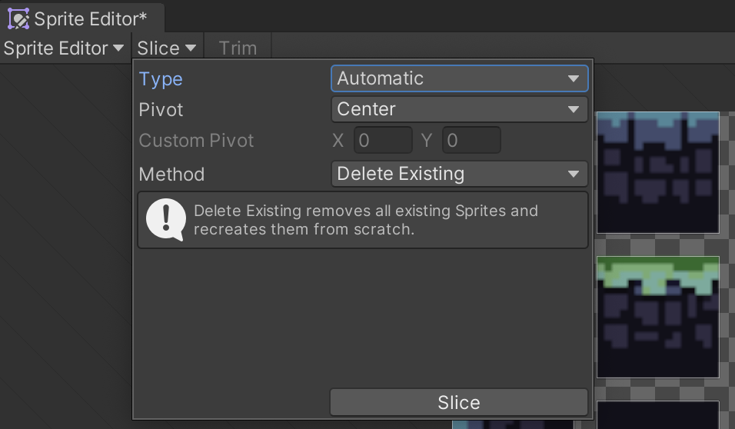
Practice – Sprites, Tilemap (Optional)
A. Practice with Slicing Sprite
1. Select all sprite assets set:
Pixel per Units: 32 and apply.
2. Select SPA_Rock_Grass_Water asset, set:
Sprite mode: Multiples and apply.
3. Select SPA_Rock_Grass_Water asset, click Spirte Editor and set:
Slice type: Automatic and apply.
Repeat steps 2 and 3 for ‘SPA_Background brown tint’
Rick Davidson, Complete C# Unity Game Developer 2D, 2023
Notes:
Reference source:
https://fpl.udemy.com/course/unitycourse/learn/lecture/28740512#overview

Slide 22
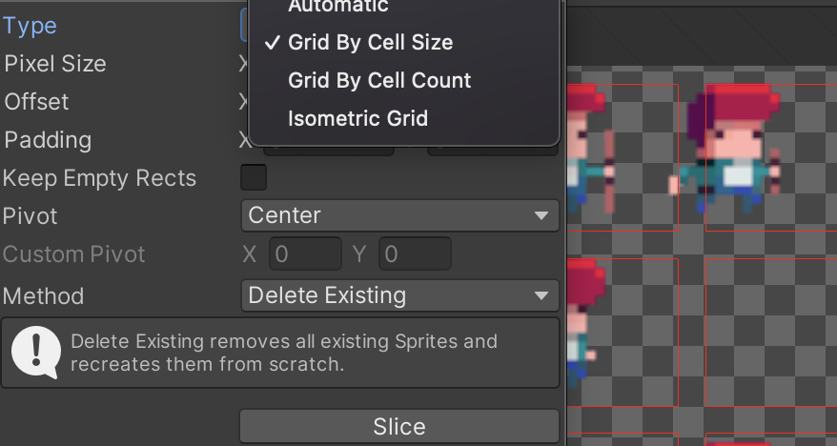
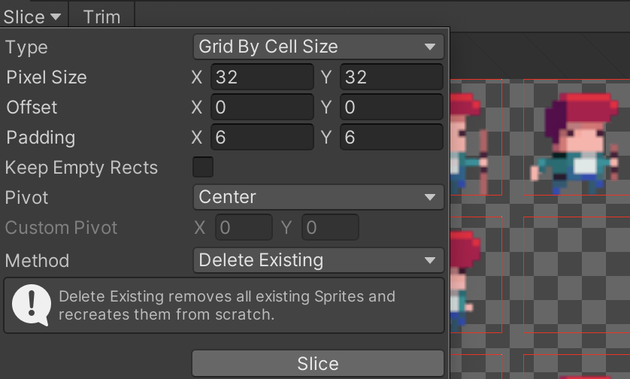
Practice – Sprites, Tilemap
A. Practice with Slicing Sprite
Slice SPA_Player_Ginger
1. Select SPA_Player_Ginger asset, set:
Sprite mode: Multiples and apply.
2. click Spirte Editor and set:
Slice type: Grid By Cell Size
3. Set params:
Pixel size: X: 32; Y: 32
Offset: X: 0; Y: 0
Padding: X:6; Y: 6
Click Slice and Apply
Repeat steps 1,2 and 3 for ‘SPA_Background brown tint’
Rick Davidson, Complete C# Unity Game Developer 2D, 2023
Notes:
Reference source:
https://fpl.udemy.com/course/unitycourse/learn/lecture/28740512#overview

Slide 23
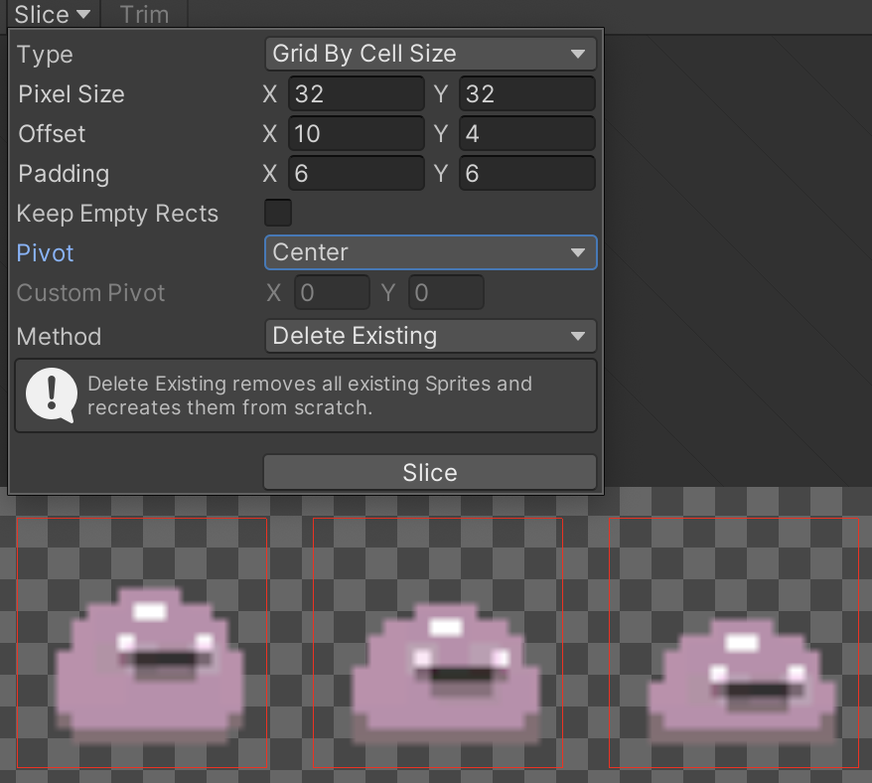
Practice – Sprites, Tilemap
A. Practice with Slicing Sprite
Slice SPA_Player_Ginger
1. Select SPA_Player_Ginger asset, set:
Sprite mode: Multiples and apply.
2. click Spirte Editor and set:
Slice type: Grid By Cell Size
3. Set params:
Pixel size: X: 32; Y: 32
Offset: X: 10; Y: 4
Padding: X:6; Y: 6
Click Slice and Apply
Rick Davidson, Complete C# Unity Game Developer 2D, 2023
Notes:
Reference source:
https://fpl.udemy.com/course/unitycourse/learn/lecture/28740512#overview

Slide 24
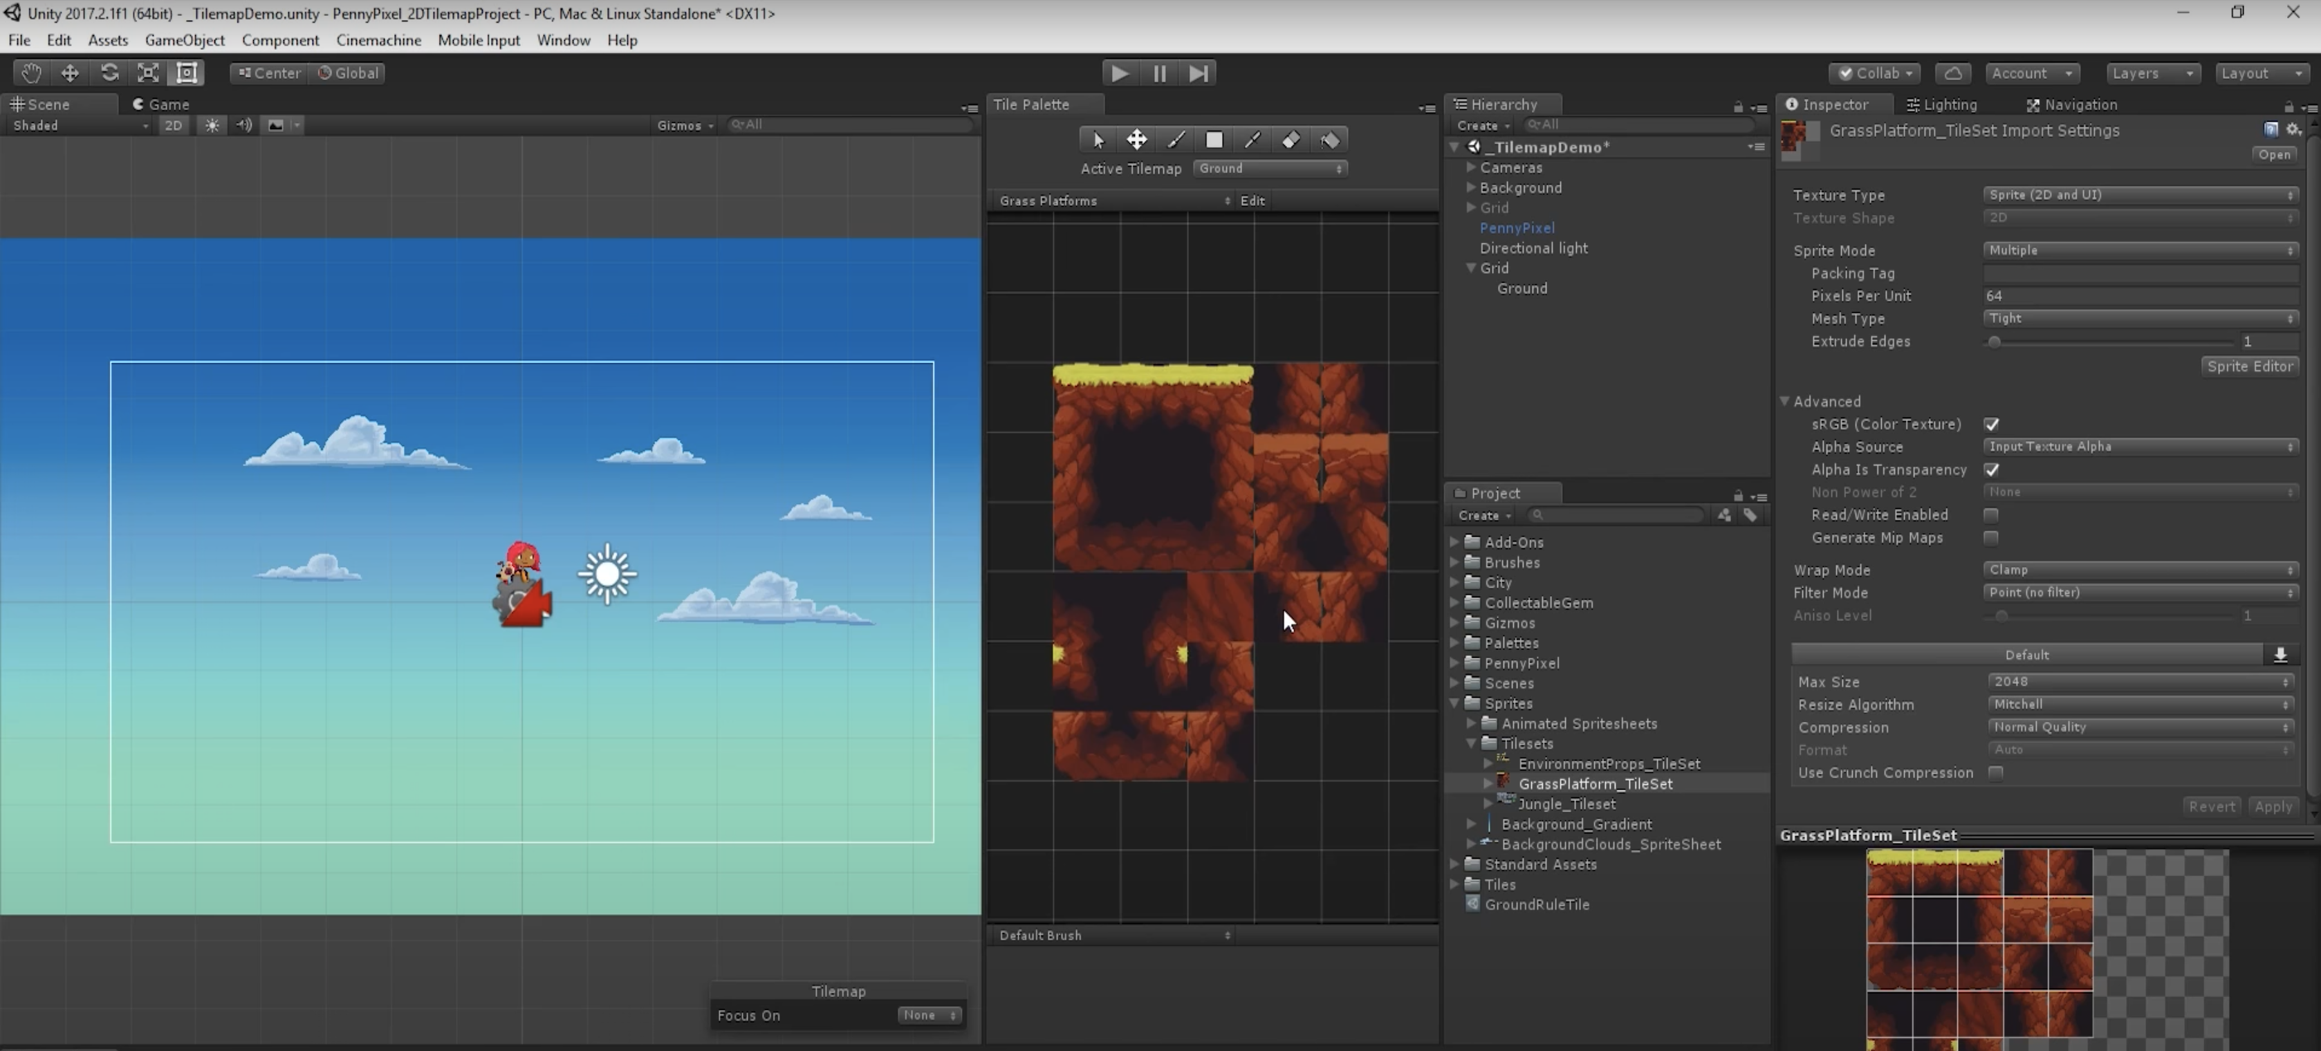
Tutorial – Tilemap: The Basic
https://www.youtube.com/watch?v=Ky0sV9pua-E&ab_channel=Unity

Slide 25
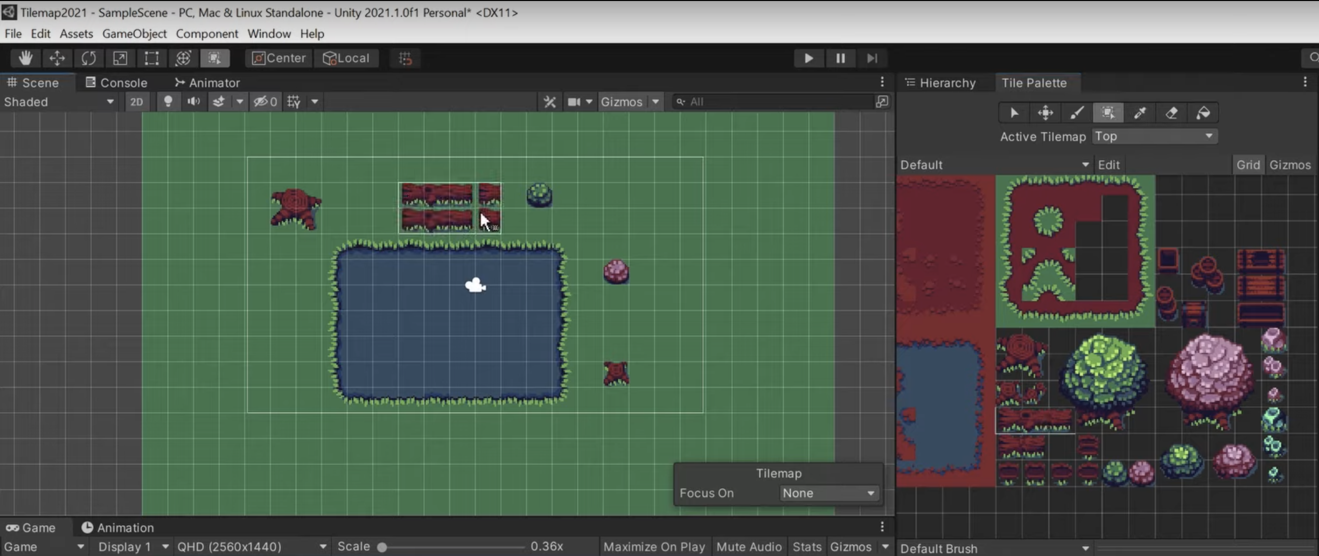
Tutorial – How to slice a sprite sheet in Unity
https://www.youtube.com/watch?v=DTp5zi8_u1U

Slide 26
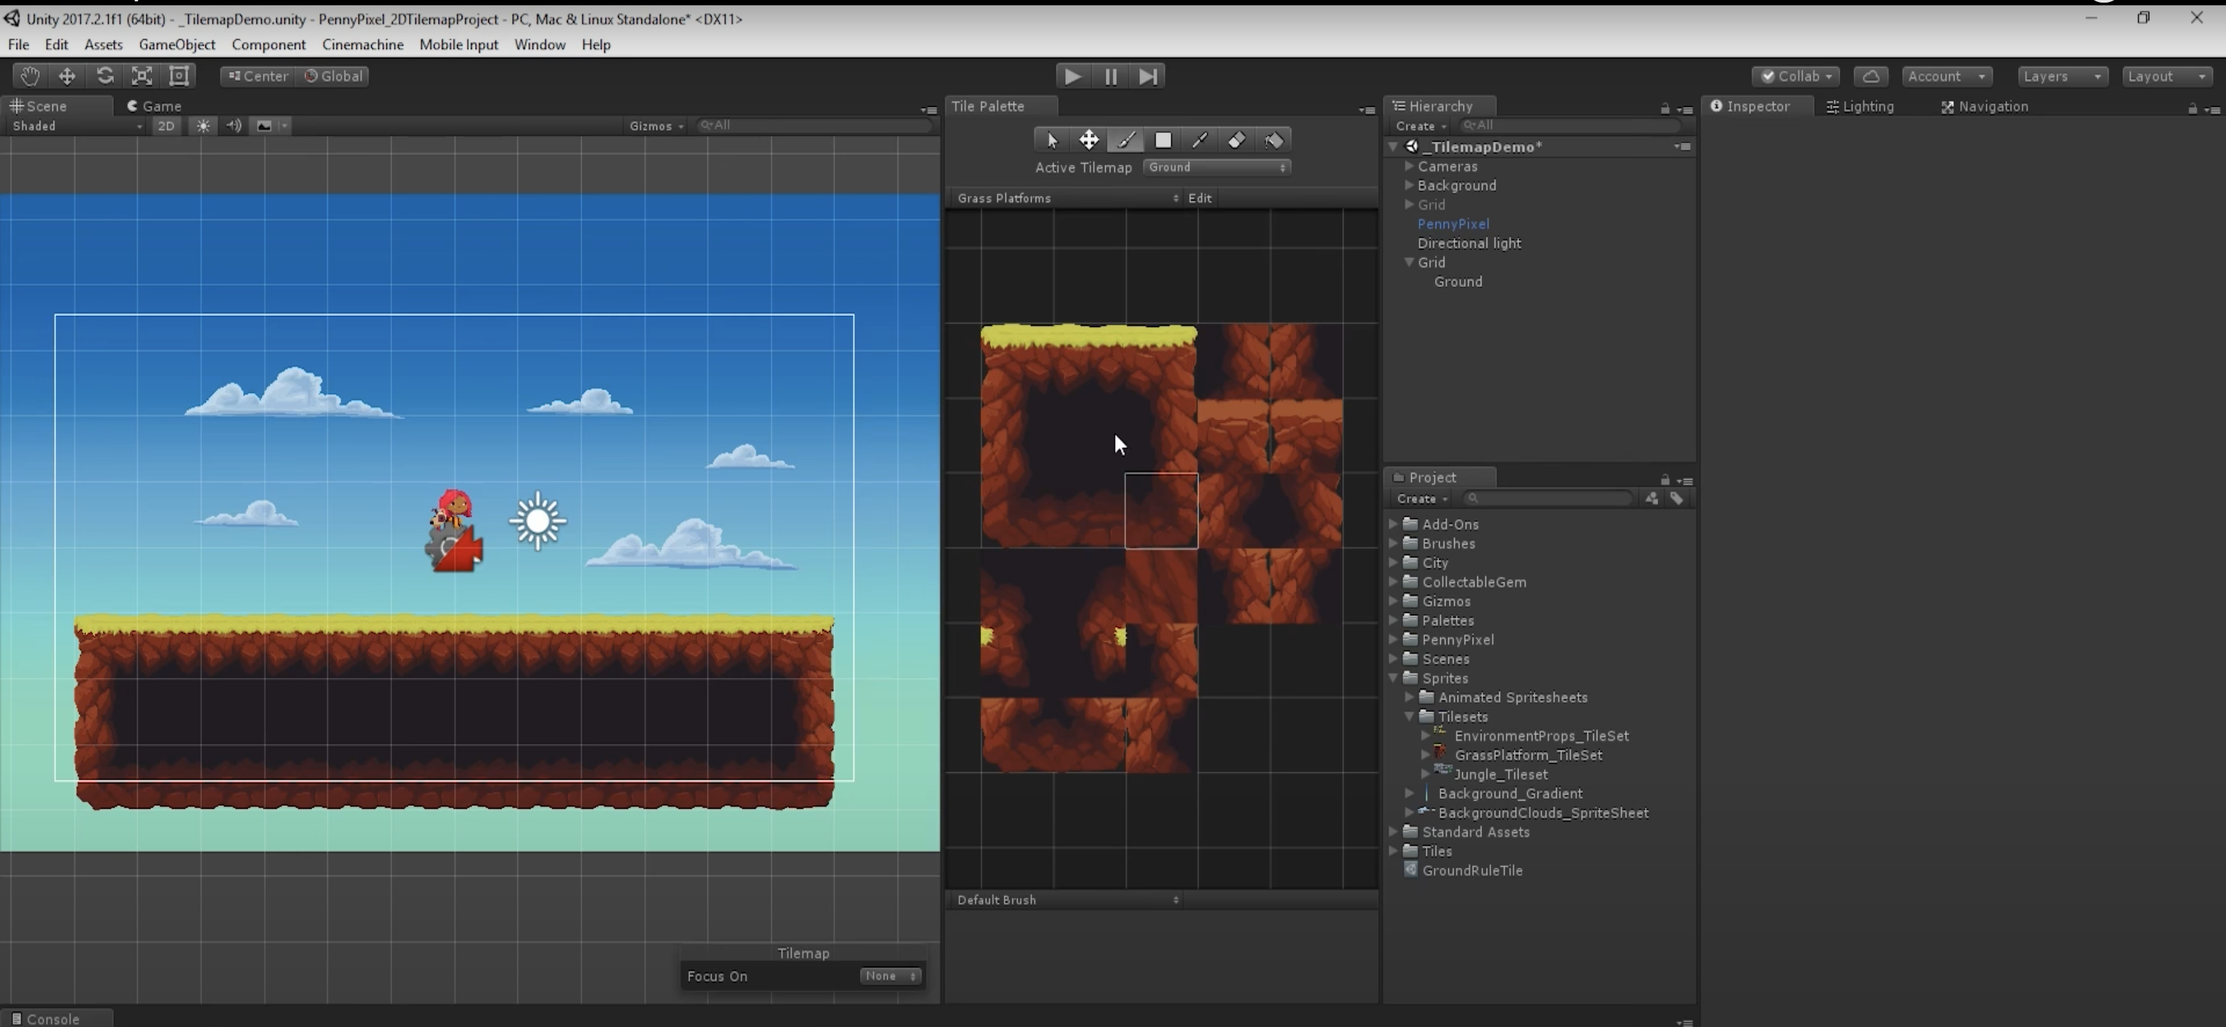
Tutorial – Tilemap: Rule Tile
https://www.youtube.com/watch?v=Ky0sV9pua-E

Slide 27
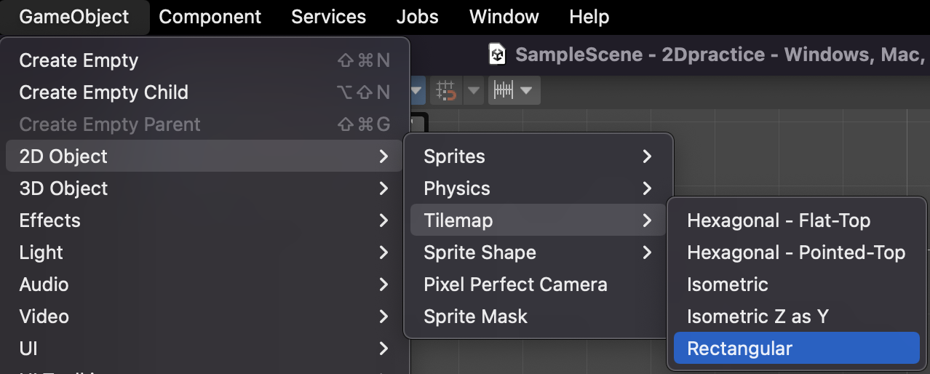
Practice – Sprites, Tilemap
B. Create Tilemap
Drag and drop ‘Tiles’ folder to Asset folder of Unity 2D project
Select GameObject > 2D Object > TileMap > Rectangular. Rename to ‘Platforms Tilemap’
Open Tile Palette by select Window > 2D > Tile Palette.
Rick Davidson, Complete C# Unity Game Developer 2D, 2023
Notes:
Reference source:
https://fpl.udemy.com/course/unitycourse/learn/lecture/28740512#overview

Slide 28
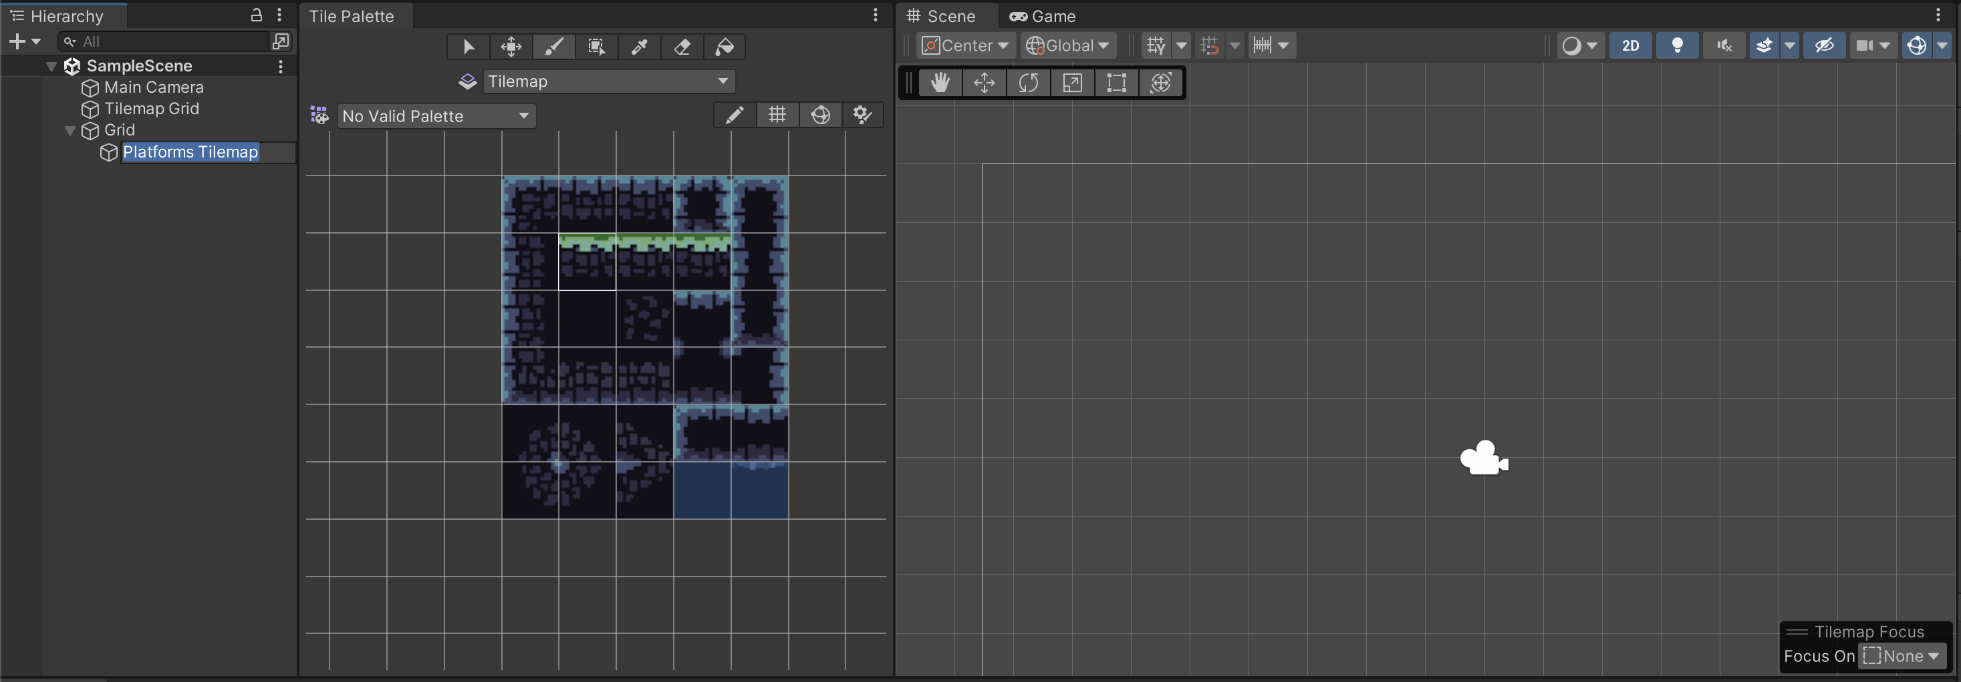
Practice – Sprites, Tilemap
B. Create Tilemap
Because we imported the ‘Tiles’ folder. 'Platforms Tilemap' will already be present in the tile palette.
Select the edit mode and use the Tile Palette toolbar to draw tiles onto the scene.
Rick Davidson, Complete C# Unity Game Developer 2D, 2023

Slide 29
Conclusions
Explored game object fundamentals and their significance in Unity scenes.
Learned manipulation techniques—selecting, moving, rotating, and scaling objects.
Mastered Transform component usage and understood coordinate systems' impact.
Grasped parent-child relationships' influence on object transformations.

Slide 30
References
1: Hocking, Joseph; Schell, Jesse, Unity in action: multiplatform game development in C#, 2022
2: Buttfield-Addison Paris, Manning Jon, Nugent Tim, Unity game development cookbook: essentials for every game, 2019
3: Geig, Mike, Sams teach yourself Unity Game development in 24 hours, 2014
8: Unity Technologies, Unity Manual, 2023

